Slide 1
4. MCM-6 Good Housekeeping at Municipal Facilities:
New Construction & Land Disturbance
Green Country Stormwater Alliance (GCSA)
Employee Training Series
Prepared by INCOG
March 2021
Notes:
This is the 4th of 6 GCSA Employee Training modules in the series covering OKR04’s Good Housekeeping 6th Minimum Control Measure (MCM-6).
This module discusses land disturbance practices at municipal sites performed by MS4 staff.
The education topics covered in this training module apply to the 6th Minimum Control Measure (MCM-6) on Good Housekeeping.
However, these same Best Management Practices (BMPs) also apply to construction that falls under DEQ’s OKR10 general permit for construction activities.

Slide 2
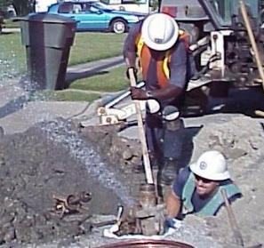
Types of MS4 Activities Affected
This presentation provides suggestions for municipal utility construction and repairs to:
    Water and sanitary sewer lines
    Storm drain system
    Streets, sidewalks and parking lots
    Landscaping (parks, buildings, medians)
    Power pole installation and replacement
Notes:
There are many types of construction and soil-disturbance actions involved with daily activities by cities and counties.
These include making repairs to and new construction of water, sewer and other utility lines and appurtenances.
In fact, all construction activities for all Public Works infrastructure can generate stormwater pollution.
The OKR10 permit applies to disturbances of 1 acre or more, or to smaller disturbed areas if they are part of a Common Plan of Development.
However, MCM-6 of the OKR04 permit has no disturbance size cutoff; any soil disturbance from any municipal activity must have pollution controls.
OKR04’s MCM-6 requires the MS4 to have “an operation and maintenance program that includes a training component and has the ultimate goal of preventing or reducing pollutant runoff from MS4 operations such as streets, roads, highways, parking lots, maintenance and storage yards, fueling areas, waste transfer stations, fleet or maintenance shops, salt/sand storage locations and snow disposal areas.” … “Require implementation of BMPs, including sediment and erosion controls during (a) routine maintenance, (b) water line breaks and emergency repairs, and (c) after line breaks, emergency repairs, and routine maintenance have been completed. “

Slide 3
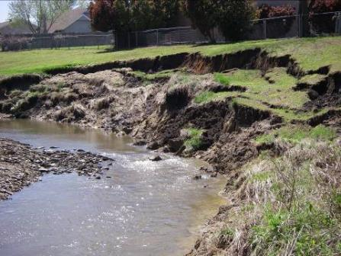
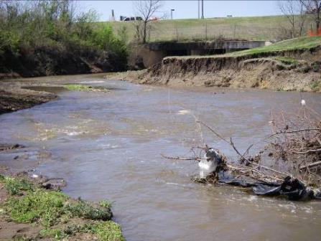
What Is Erosion?
The wearing away of soil due to the action of water.
Erosion can damage infrastructure and property.
Notes:
Stream bank erosion is one of the most common and costly water-related problems in urban areas.
The types of damaging erosion in the Slide 3 pictures is usually not found in rural settings that have an abundance of native natural vegetation.
Unlike rural settings, urban areas have a significant amount of “impervious surface” (hardened surfaces that do not allow rainfall to soak into the ground).
Examples of impervious surfaces include streets, sidewalks, parking lots, rooftops and driveways.
Urban rainfall events have a rapid rise in velocity and volume of water, often called “flash flows”. This is due to having much more runoff that was not able to soak into the ground.
These intense flash flows gouge away stream banks, cutting through soils and plant roots.
This “erosion” of soils from flash flows results in property damage and even property loss as large portions of land are carried downstream.
Eroded stream banks can also expose water and sewer lines and destroy other city infrastructure, such as streets and culverts.

Slide 4
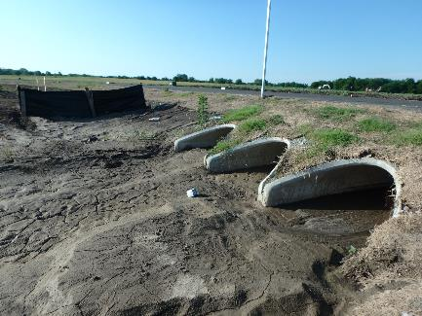
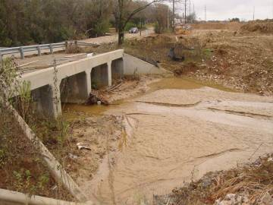
What Is Sedimentation?
The depositing of soil particles that settle out of flowing water.
Sediment buildup destroys stream habitat and blocks flow.
Notes:
As the massive amounts of eroded soil (usually called “sediment”) are carried downstream, stream velocities dissipate, and the suspended sediment deposits into the stream.
Often these sediment depositions can be extensive resulting in blockage of stormwater conveyance systems.
In addition, sediment can bury healthy aquatic plants and animals destroying the stream’s ecosystem.
Once such sediment buildup occurs, there are no natural stream flow processes that will clean out the accumulated sediment.
Cities and counties must turn to mechanical means to remove sediment, such as grading and dredging.
These operations are costly, and it is often difficult to access the locations that must be cleared.
Both the OKR10 permit for construction activities and the OKR04 permit’s MCM-6 provisions require use of BMPs to prevent erosion and sedimentation.

Slide 5
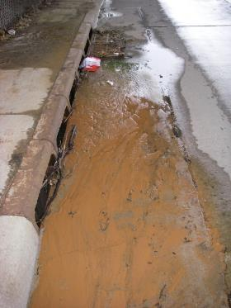
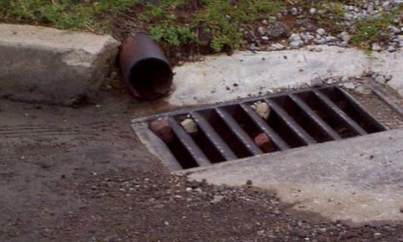
Pollution In Storm Drains
  Keep chemicals, dirt and debris out of the storm drain system.
  This will prevent pollution of nearby creeks and ponds.
Notes:
The curb and drop inlet in the right picture in Slide 5 is funneling everything into the storm drain.
There is an accumulation of sediment all around the drain waiting to be washed in.
The drop inlet in the picture on the left shows a pipe discharging directly into the storm drain.
There are also accumulations of dirt and small gravel that will be washed into the drain with the next runoff flow.
OKR04’s MCM-3 (for Illicit Discharge Detection and Elimination – IDDE) requires the permitted MS4 to investigate the nature of the pipe discharge.
MCM-3 also requires that the MS4 use local enforcement to stop this pipe’s discharge.
If the pipe is coming from a facility owned by the MS4, then this “illicit discharge” falls under OKR04’s MCM-6 as well.

Slide 6
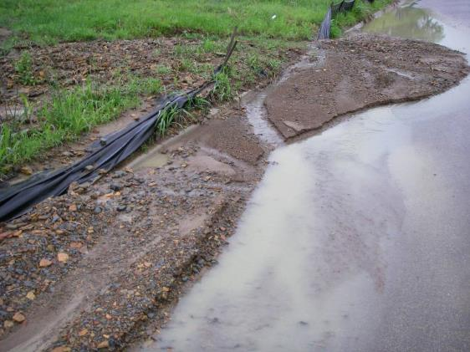
Land Disturbance BMP Failure
  BMP failures are often caused by poor installation or lack of BMP maintenance.
Notes:
Silt fences won’t work if they are not maintained. Notice the vegetation growing on the silt. This has been going on for sometime.
Notice how the sediment has built up to the point that the curb is buried.
Water is cutting a channel through the island of sediment in the road and has washed away the downstream portion of the island.
Also notice the particle size. This isn’t just fine silt. There have obviously been large volumes of water flowing across this site.
Up-gradient from this silt fence is a very large area of cleared ground on a fairly steep slope.
It is all too frequent to find silt fencing that is neglected to the point it fails to function at all.

Slide 7
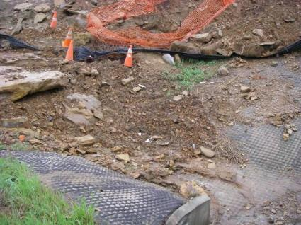
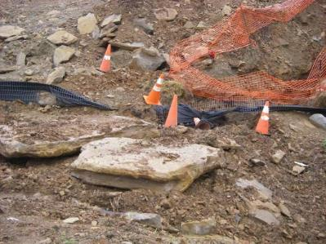
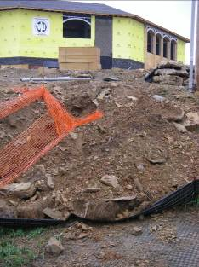
BMPs: Multiple Failures
Improper installation.
No maintenance.
BMP not suitable to site.
Notes:
How many BMP failures can you see in these pictures?
A standard industry practice is to remove sediment built up along a silt fence once it reaches half way to the top of the fencing.
Large slabs of broken concrete and rock have been graded or unloaded onto the fencing effectively destroying the silt fence barrier.
Silt fences alone are not designed to stop such large quantities of dirt and rock.
The purpose of silt fencing is to prevent eroded sediment from continuing downslope in runoff.

Slide 8
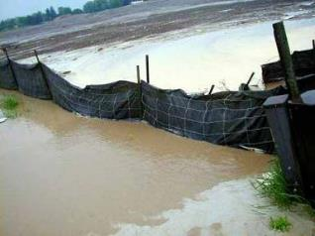
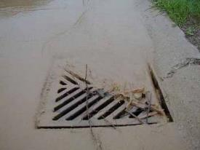
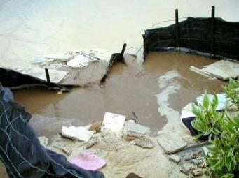
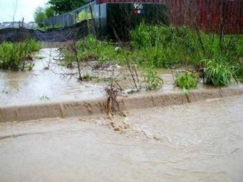
More BMP Problems
Silt fence failures.
Trash pollution.
Sediment transport.
Notes:
It’s amazing how much sediment (dirt) can be transported in flowing water.
If not prevented, transported sediments will enter storm drain systems where they will accumulate and block future flows of stormwater.
Cleaning underground storm drain pipes is costly and requires specialized equipment.
The silt fences in these pictures were not installed properly; notice the gaps of daylight under the fencing which allows water to easily flow under the fence.
One of these silt fences has been so neglected that not even floating trash is held back.

Slide 9
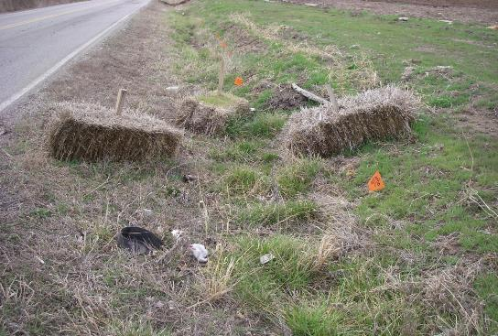
Hay Bales No Longer Acceptable
OKR10: “straw or hay bales as BMP controls… are not allowed.”
Too many “blow-outs” from runoff flows.
Can be used to help support silt fencing.
Notes:
There was a time when straw and hay bales were popular methods for controlling stormwater flows.
As BMP deployment at construction sites became required by stormwater permits, straw bale BMP effectiveness was questioned.
It is now apparent that straw and hay bales can no longer by used as effective BMPs for managing stormwater flows.
The OKR10 permit, in fact, prohibits the use of straw and hay bales as BMP controls.
The bales themselves are very difficult to keep in place by staking, and they frequently break apart.
The picture in Slide 9 shows a typical bale failure in a drainage channel.
Some contractors still use bales at construction sites, but only to add additional support to properly installed silt fencing.
Straw and hay bales themselves are not allowed.

Slide 10
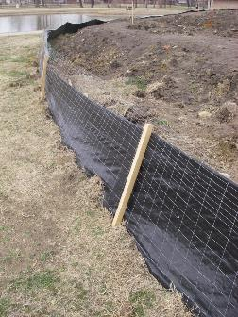
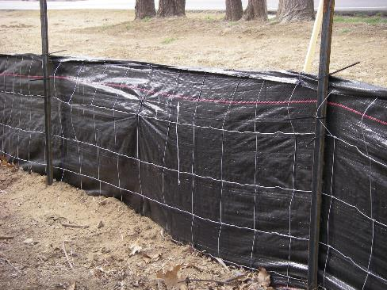
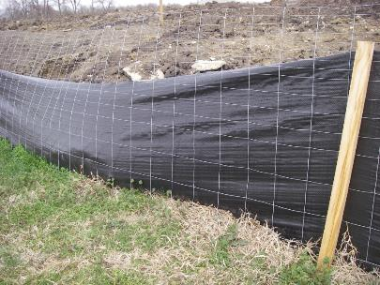
Properly Installed Silt Fencing
Examples of proper installation of silt fencing.
Time for some maintenance?
Notes:
Silt fences must be “trenched” in place and staked on the downslope side, preferably with some type of supporting wire mesh.
There should be no gaps between the bottom of the fence and the ground.
Silt fences are not designed to hold back tons of dirt; they are designed to stop sediment-laden water flows from runoff, allowing the sediment to accumulate.
An industry standard is to clean out the accumulated sediment once it is half-way to the top of the fence.
Always follow manufacturer’s installation and maintenance guidelines.
Also verify with your stormwater permit and local codes on what is required for placement and any limitations on uses of silt fencing.

Slide 11
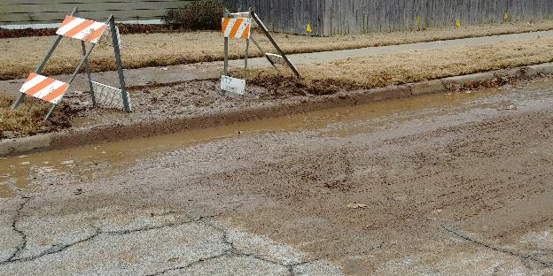
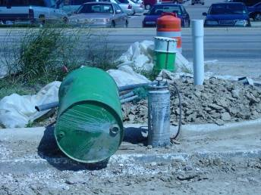
Sediment Controls for MS4 Projects
MS4 projects must also control pollution (MCM-6).
This includes keeping sediment and other pollutants from entering storm drains (MCM-6).
Notes:
MCM-6 requirements in OKR04 apply to any construction-related pollution generated by a municipal crew, even while making repairs.
OKR04 states that the MS4 must implement “…BMPs, including sediment and erosion controls during (a) routine maintenance, (b) water line breaks and emergency repairs, and (c) after line breaks, emergency repairs, and routine maintenance have been completed.”
MCM-6 has a provision to: “Ensure appropriate actions are taken that may be necessary to ensure public health and safety.”
This was added to confirm that stormwater controls should not interfere with any public health and safety issues to which the construction applies.
The OKR04 MCM-6 requirement to control pollution from local utility projects has been difficult to implement.
Stormwater managers often are not able to successfully work with Public Works supervisors and crews who manage utility projects.
In addition, very small projects, such as repairing small line breaks, do not have effective BMPs that can be used during the work.
This is an ongoing problem for MS4s and for DEQ oversight and enforcement.

Slide 12
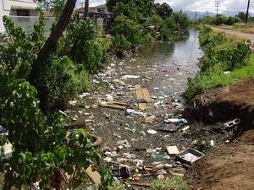
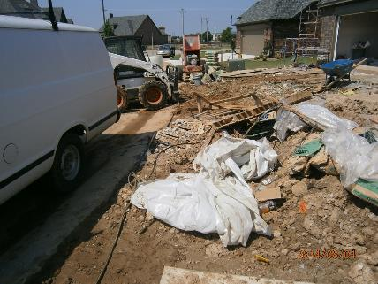
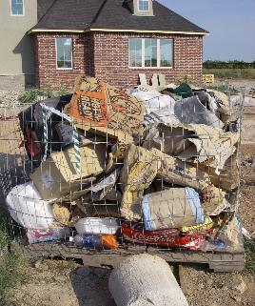
Controlling Trash and Chemicals
Trash and chemicals are potential stormwater pollutants.
These include paper, plastics, debris, oil, grease, fuels, lime, concrete truck wash water, solvents, etc.
Notes:
Construction sites generate significant quantities and a wide variety of trash and debris.
Most of these discarded materials float in water, and much gets carried offsite by even moderate winds.
EPA has classified floating materials, such as trash and discarded debris, as “floatables”, a type of pollution that is specifically prohibited in OKR04 and OKR10.
There are effective ways to control trash at construction sites, but it requires containment devises, training of employees and regular maintenance to be effective.
Construction sites also contain a variety of chemicals used on site, including paints, solvents, fuels, oils, grease, pesticides and herbicides, fertilizers and other liquids and solids.
These chemicals must be properly stored and, if possible, kept under shelter or in storage away from rainfall and runoff.

Slide 13
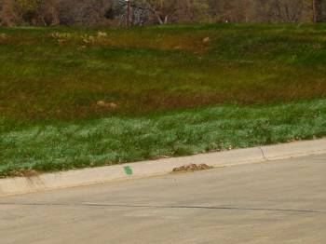
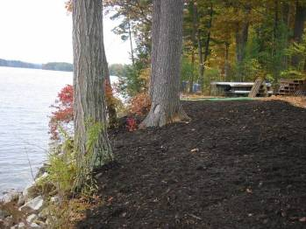
Erosion Control BMPs
  Vegetation - grasses or other plants that provide erosion protection.
  Mulching - a layer of straw, wood or synthetic material that covers the loose soil.
Notes:
Growing plants are an important tool in the BMP toolbox for controlling erosion at construction sites.
Plant roots help hold the soil in place, and the leaves lessen the impact of rain drops and help slow the flow of surface water.
When live plants cannot be used, mulch is a valuable substitute.
Mulch also protects soil from erosive rainfall and helps hold in soil moisture.

Slide 14
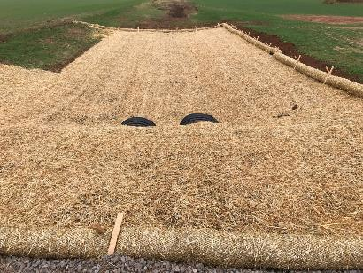
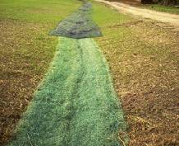
Erosion Control BMPs
Preventing erosion is more effective than trying to remove sediment from runoff (source control).
Combine erosion control BMPs for best effect.
E.g., try combining vegetation, mulch, wattles and matting BMPs.
Notes:
Use mulching, matting, netting and other erosion controls to help hold soil in place and establish vegetation as soon as possible.
Roll out sod in critical areas when you don’t have time to wait for seeds to sprout and grow.
Many types of mulch are infused with fertilizers and seeds.
Liquid forms of these mixtures can be sprayed onto bare ground to cultivate erosion control plants.
It is best to employ several different BMPs together at a site.
The combination of BMPs can help support and improve the effectiveness of the other BMPs.

Slide 15
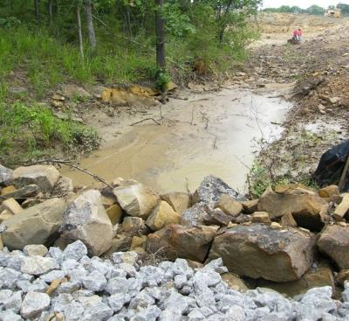
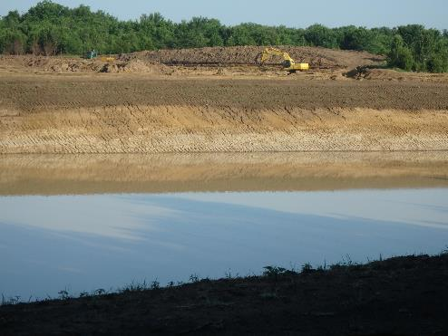
Sediment Basin BMPs
  Sediment Basin – a pond constructed to detain water and allow sediment to settle out before discharge.
  Can be small or large.
Notes:
OKR10 requires the use of sedimentation basins, or some effective substitute, under certain types of construction conditions.
The basin collects water flowing from the construction site that is laden with eroded sediment where it is then deposited.
After a time, as sediment accumulates, the basin must be dredged or cleaned out to retain the usefulness of the basin.
Sediment basins can be small or quite large in size, depending upon the nature of the construction site.
Consult the OKR10 permit and local codes for proper construction and maintenance of sediment basins or for use of accepted substitutes.

Slide 16
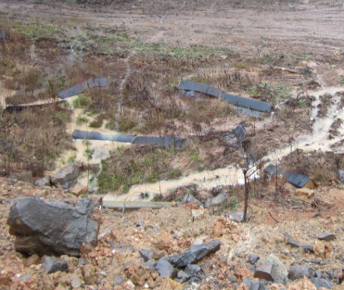
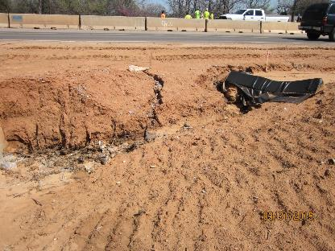
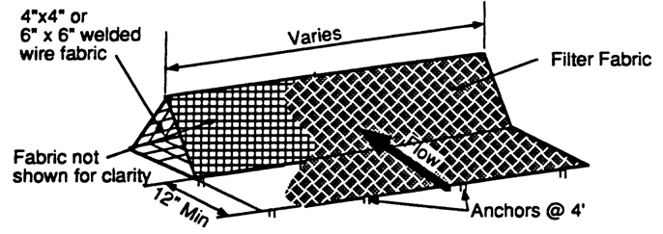
Triangle Sediment Dike BMP
  Filter fabric placed over welded wire shaped into a triangle.
  Must be installed properly and maintained.
Notes:
A variation on the silt fence concept is a triangle sediment dike.
These BMPs are designed to allow the passage of water, but they detain sediment.
Triangle sediment dikes should only be used for circumstances allowed by the OKR10 permit and local codes.
As with all BMPs, proper installation and maintenance is essential.

Slide 17
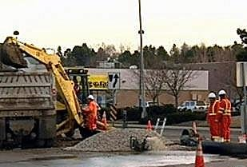
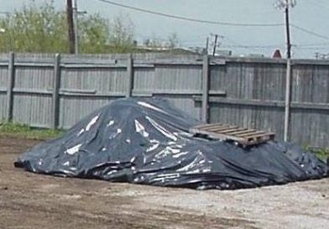
Dirt Stockpile BMPs
Locate dirt stockpiles out of the street and away from runoff.
Locate stockpiles outside of flood-prone areas.
Cover stockpiles with plastic tarps.
Use a berm or silt fence around the pile as runoff capture.
Notes:
Invariably, construction activities require the use of dirt, sand, gravel and other loose materials that are typically dumped on the ground in a stockpile.
Most of these materials can leach into runoff when exposed to rainfall.
BMPs should be used to contain or prevent loss of materials in runoff.
These include covering stockpiles with tarps, storing in rainproof shelters or using some type of runoff control BMPs around the piles of materials.

Slide 18
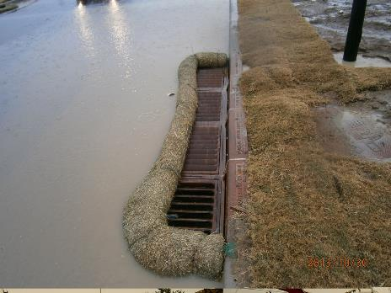
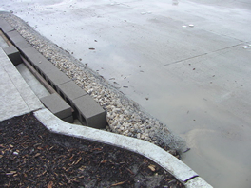
Inlet Protection BMPs
  Inlet protection BMPs are “secondary” – to be used with other BMPs to prevent sediment and trash from entering storm drains.
  E.g., concrete blocks and stone or wattles placed around inlet.
Notes:
There are many methods to protect drop inlets from sediment and trash pollution.
These BMPs are designed to allow the passage of water, but detain sediment.
Inlet protection BMPs by themselves can get overwhelmed quickly and lead to failure.
Therefore, inlet protections should be considered “secondary” and used in conjunction with other BMPs.

Slide 19
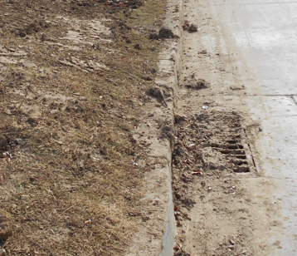
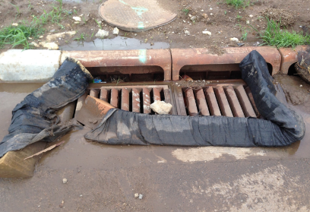
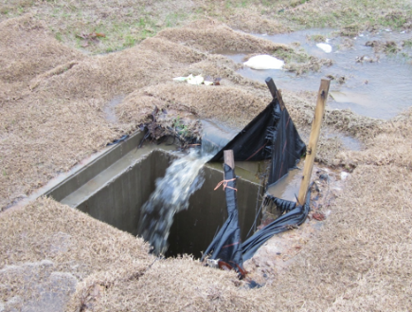
Inlet Protection BMPs
  Use with other BMPs.
  Install all BMPs properly.
  Maintain all BMPs.
Notes:
As with all other stormwater BMPs, inlet protection BMPs must be installed properly, they must be suitable to the site conditions, and they must be properly maintained.
It is not uncommon for inspectors to find that the only stormwater protection applied on site is at drop inlets.
Use inlet protection along with other stormwater control BMPs.
The site’s unique conditions and circumstances will dictate the best choices for BMPs.

Slide 20
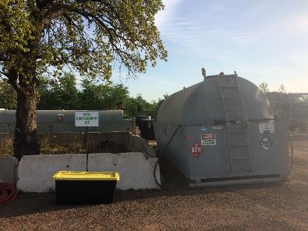
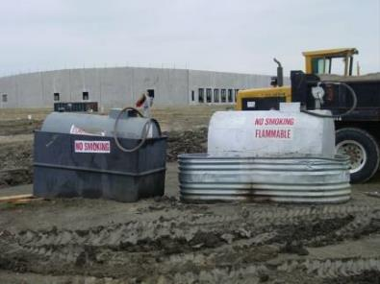
Fuel and Chemical Storage BMPs
  OKR10 prohibits construction site discharges from “fuels, oils, or other pollutants used in vehicle and equipment operation and maintenance;”
OKR10 also requires: “store chemicals in water-tight containers, and provide either cover… or provide secondary containment (e.g., spill berms, decks, spill containment pallets);
Notes:
Fuel and chemical storage BMPs can be relatively inexpensive and effective.
For example, a galvanized water tank for cattle can be used as secondary containment. It is simple, inexpensive and effective.
Spills or leaks will be contained and easy to clean up if they occur by use of some type of secondary containment.
OKR10 allows alternatives to open tanks, such as spill berms, decks or pallets.

Slide 21
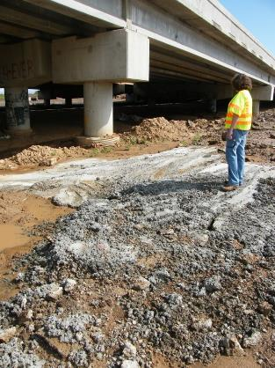
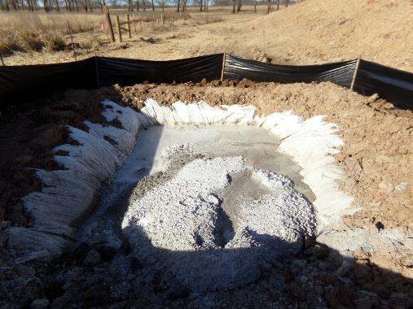
Concrete Washout BMPs
  Capture wash water from concrete truck cleaning at designated locations to prevent wash water runoff from entering the storm water system.
Notes:
Illegal disposal of concrete truck washout continues to be a problem at and near construction sites.
Wash water from concrete trucks should be discharged into a designated pit or low area on site. Water will then evaporate and seep into the soil leaving the cement to set.
When the cement is set, it can be hauled off. This will keep the washout cement from setting up in your storm sewers and keep the particulates out of the creeks.
Concrete wash water not only carries fine particulates, but it is very high in pH. Both readily harm aquatic life in nearby streams and ponds.

Slide 22
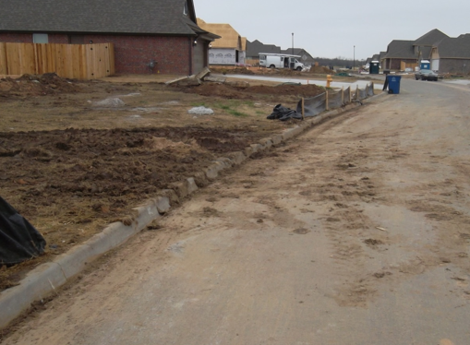
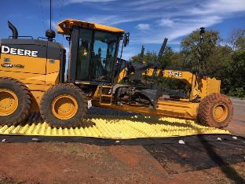
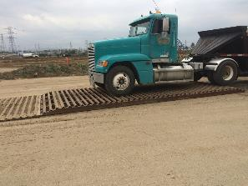
Site Exit Track Out BMPs
  Wheel washing, rumble strips, rattle plates, large stone, etc.
  Remove tracked out sediment by the end of each workday.
Notes:
One of the most common complaints from citizens about construction site pollution is the accumulation of dirt and mud at site entrances / exits.
Streets are defined in the OKR04 permit as part of the MS4 stormwater collection system to which the OKR04 coverage applies.
Any tracking of dirt, mud, chemicals or other pollutants into streets from any type of construction activity is prohibited.
This type of pollution into the MS4 is prohibited by OKR10, and by OKR04’s MCM-3 and MCM-6 provisions.
There are effective means to control track out of dirt and mud; most rely upon some type of rumbling agitation from large stones or corrugated strips.
Regardless of the dislodging BMP used, at the end of each work day the street exist areas should be swept clean of any materials that were carried off site.

Slide 23



End of Module 4 on
New Construction and Land Disturbance
Vernon Seaman
Manager, Envir. And Energy Planning
INCOG
Two West 2nd Street, Ste 800
Tulsa, OK 74103
(918) 579-9451
vseaman@incog.org
Notes:
This concludes the 4th of 6 annotated PowerPoint (aPPT) Modules for local MCM-6 training.
Training Presentations 2 through 5 cover the training subjects listed in the OKR04 permit.
The final Presentation 6 covers additional facilities that may be owned by GCSA Members.
INCOG expects to be able to return to physical half-day GCSA Employee Training Workshops in the second half of 2021.
In this interim period, INCOG will continue to prepare annotated PowerPoints (aPPTs) for local staff training use.

